Slide 1
Ethics Across the Intercultural Development Continuum
Activity created by Dr. Kris Acheson-Clair and Dr. Kenneth Tanemura, CILMAR

Slide 2
The Intercultural Development Continuum (IDC)
A developmental model describing orientations toward cultural differences.

Slide 3
Intercultural Development Continuum (IDC)
Adaptation
Bridging difference
Acceptance
Deeply comprehending difference
Minimization
De-emphasizing difference
Polarization
Judging difference
Denial
Missing difference

Slide 4
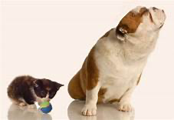
1. Denial
A Denial mindset reflects a more limited capability for understanding and appropriately responding to cultural differences in values, beliefs, perceptions, emotional responses, and behaviors.
@willeecole. (n.d.). Dog Ignoring Playful Kitten. Dreamstime. https://www.dreamstime.com/royalty-free-stock-images-dog-ignoring-playful-kitten-image7522639
Notes:
Note to facilitators: Ask learners to explain why the animal photo on each slide is a good illustration of the orientation.

Slide 5
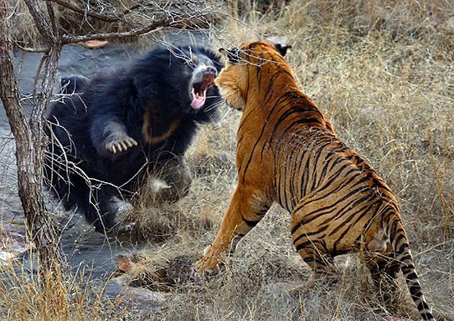
2. Polarization
Within Polarization, cultural differences are often seen as divisive and threatening to one’s own “way of doing things.” When Polarization is present in an organization, diversity typically feels uncomfortable.
Who is stronger – a bear or a tiger? Predators in nature. (n.d.). https://eng.agromassidayu.com/kto-silnee-medved-ili-tigr-hishniki-v-prirode-news-720468
Notes:
Note to facilitators: Ask learners to explain why the animal photo on each slide is a good illustration of the orientation.

Slide 6
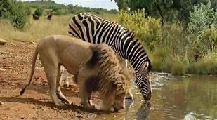
3. Minimization
Minimization highlights commonalities in both human similarity (basic needs) and universalism (universal values and principles) that can mask deep, impactful cultural differences.
Lion and Zebra drinking from watering hole. (n.d.). Imgur. https://i.imgur.com/VgBiW8p.jpg
Notes:
Note to facilitators: Ask learners to explain why the animal photo on each slide is a good illustration of the orientation.

Slide 7
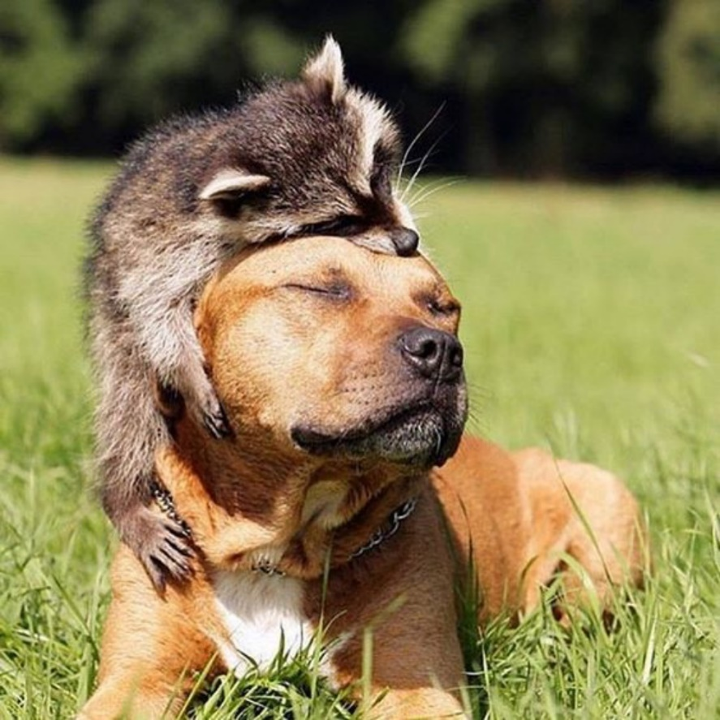
4. Acceptance
In Acceptance, individuals and organizations recognize and appreciate patterns of cultural differences and commonalities in their own and other cultures. In the Acceptance orientation, people are curious to learn how values and behaviors makes sense within different cultural communities.
Unlikely friendship. (n.d.). Freekibble. https://www.freekibble.com/unlikely-friendships-44/
Notes:
Note to facilitators: Ask learners to explain why the animal photo on each slide is a good illustration of the orientation.

Slide 8
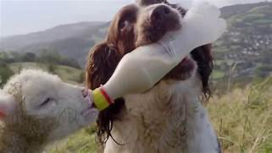
5. Acceptance
An Adaptation orientation consists of both shifting your cultural perspective and changing behavior in authentic and culturally appropriate ways. Adaptation enables people to negotiate in complex situations who can/will accommodate others.
Jess Being ‘Mom’ to an Orphaned Lamb. (n.d.). Libredd.it. https://libredd.it/r/AnimalsBeingMoms/comments/oc7g2z/jess_being_mom_to_an_orphaned_lamb/
Notes:
Note to facilitators: Ask learners to explain why the animal photo on each slide is a good illustration of the orientation.

Slide 9
What are ethics?
What people find good and right within each stage of the IDC.
Notes:
Note to facilitators: Ensure that participants understand what ethics are and how they tie into each IDC stage. A definition of ethics will be important to establish early in on in order to facilitate small and large group discussion time later in the activity.

Slide 10
How do ethics inform each of the IDC stages?
What people find good and right within each stage of the IDC.
Denial
Polarization
Minimization
Acceptance
Adaptation
As long as we speak the same language, there’s no issue.
These people are sexist/racist/etc.
I don’t see color, and no one should!
I acknowledge our differences, but I’m learning to live together with others.
Whatever the situation, I can usually see it from various cultural points of
view, and respond effectively.
Notes:
Note to facilitators: Ask participants to name examples of ethics within each IDC stage as time allows.

Slide 11
Case Study: The dilemma of the tomahawk chop
In the National League Championship series, the Atlanta Braves’ home crowds did the tomahawk chop, something many Native Americans deem offensive. But the Major League Baseball commissioner claimed Native Americans are supportive of the Braves program, including the chop. This event has sparked a controversial debate over the appropriateness of the tomahawk chop.
Cota-Robles, M. (2021, October 29). Native American group disputes MLB commissioner's claims on Braves' use of Tomahawk Chop. ABC13 Houston. https://abc13.com/atlanta-braves-tomahawk-chop-mlb-commissioner-rob-manfred/11177839/
Notes:
Note to facilitators: Go over the first case with the group as a whole so you can talk through application of the IDC to the ethical dilemma. Try to encourage dialogue (more than one learner responding to each slide). In these cases, it is much less important for learners to correctly identify one right answer with each slide, and more important for them to engage in thinking through the implications of different perspectives in an ethical dilemma/cultural conflict. You might mention before you begin talking about the cases that we aren’t labeling PEOPLE as definitely being in an orientation based on what they said. Instead, we are identifying the orientation towards difference reflected in their comments – that may or may not be their habitual response to cultural difference.

Slide 12
Some reactions to the tomahawk chop debate
“We have a tendency to do this where in an effort to be sensitive to other cultures we actually eliminate some of the championing of the cultures… What about the tomahawk chop is demeaning to Native Americans? What is offensive about a war chant?” –Doug Gottlieb (Leitner, 2021)
Which of the five stages of the IDC does this passage align with:
Denial
Polarization
Minimization
Acceptance
Adaptation
Missing difference
Judging difference
De-emphasizing difference
Deeply comprehending difference
Bridging difference
Notes:
Note to facilitators: This quotation only champions one viewpoint and can’t imagine other valid perspectives – that sounds like Polarization. Note the use of first and third person (we vs Native Americans).

Slide 13
Some reactions to the tomahawk chop debate
“On Tuesday, Manfred said that the league tries to stay apolitical and that this year it made a rare exception, noting that its fans have diverse points of view and ‘we’d like to keep the focus on the field.’” –Robert Manfred (Wagner, 2021)
Which of the five stages of the IDC does this passage align with:
Denial
Polarization
Minimization
Acceptance
Adaptation
Missing difference
Judging difference
De-emphasizing difference
Deeply comprehending difference
Bridging difference
Notes:
Note to facilitators: Indicators of a Denial orientation include a desire to stay “apolitical” and “keep the focus” on baseball rather than culture.

Slide 14
Some reactions to the tomahawk chop debate
“’I don’t know how every Native American group around the country feels,’ Manfred said. ‘I am 100% certain that the Braves understand what the Native American community in their region believes and that they’ve acted in accordance with that understanding.’” –Robert Manfred (Odum, 2021)
Which of the five stages of the IDC does this passage align with:
Denial
Polarization
Minimization
Acceptance
Adaptation
Missing difference
Judging difference
De-emphasizing difference
Deeply comprehending difference
Bridging difference
Notes:
Note to facilitators: Minimization favors simplistic solutions to cultural conflicts in the interest of getting along and emphasizes understanding others, at least superficially.

Slide 15
Some reactions to the tomahawk chop debate
“On the other hand, some Braves fans still do the ‘tomahawk chop’ arm gesture and chant, which are increasingly considered both offensive and outdated. Teams from the pro leagues to high school athletics are moving away from derogatory slogans and this particular expression of enthusiasm.” –NPR (Treisman & Goldman, 2021)
Which of the five stages of the IDC does this passage align with:
Denial
Polarization
Minimization
Acceptance
Adaptation
Missing difference
Judging difference
De-emphasizing difference
Deeply comprehending difference
Bridging difference
Notes:
Note to facilitators: Acceptance typically demonstrates understanding of other perspectives but doesn’t offer a proactive solution to conflict.

Slide 16
Some reactions to the tomahawk chop debate
“Instead of continuing to perform a ‘war chant’ rooted in stereotypes popularized more than a century ago, fans in Atlanta and Tallahassee and wherever else it’s still being done might benefit from listening to actual music created by Native American tribes that were forcibly relocated by the United States government in the mid-19th century.” –Slate Magazine (Fatsis, 2021)
Which of the five stages of the IDC does this passage align with:
Denial
Polarization
Minimization
Acceptance
Adaptation
Missing difference
Judging difference
De-emphasizing difference
Deeply comprehending difference
Bridging difference
Notes:
Note to facilitators: We can see Adaptation in play here in the focus on behavior, and other people’s perceptions of the appropriateness of those behaviors. Note that this is not the only potential solution offered by an Adaptation perspective. Can learners think of any others that negotiate who should adapt to whom in a nuanced way that considers multiple perspectives?

Slide 17
Some reactions to the tomahawk chop debate
“Suzan Shown Harjo, a Native rights advocate, said the entire practice of using Native people or culture for sports and entertainment is racist.” –CNN (Terry Ellis, 2021)
Which of the five stages of the IDC does this passage align with:
Denial
Polarization
Minimization
Acceptance
Adaptation
Missing difference
Judging difference
De-emphasizing difference
Deeply comprehending difference
Bridging difference
Notes:
Note to facilitators: Polarization is evidenced by black and white rather than nuanced understandings, and an us vs. them mentality. All or nothing statements, especially those that place blame, often come from from the Polarization orientation.

Slide 18
Whole Group Questions
Which of these perspectives do you identify with most?
Which do you hear in your communities and classrooms?
What are the ethical implications of these positions? That is, what are the risks of potential harm for various groups based on these different orientations and the courses of action they advocate for as best or right?

Slide 19
Small Group Discussion
Notes:
Note to facilitators: If time allows, you can now move to a small group setting for the second case. You might refresh their memory on the orientations before introducing the case and splitting into groups. One way to arrange groups is to have 6, since there are 6 quotation slides. Assign one to each group for analysis and them have them report back when you return to breakout.

Slide 20
Intercultural Development Continuum (IDC)
Adaptation
Bridging difference
Acceptance
Deeply comprehending difference
Minimization
De-emphasizing difference
Polarization
Judging difference
Denial
Missing difference

Slide 21
Another Case Study: ESPN's Stephen A. Smith apologizes for criticizing Shohei Ohtani's use of interpreter
The Cauldron. (2021, July 12). First take Shohei Ohtani [Video]. YouTube. https://www.youtube.com/watch?v=oB_sZQIbUxQ. 12 July 2021

Slide 22
Another Case Study: ESPN's Stephen A. Smith apologizes for criticizing Shohei Ohtani's use of interpreter
“In a segment on ESPN's morning talk show ‘First Take,’ Smith said Monday that Ohtani, a Japanese-born Major League Baseball sensation who has drawn comparisons to Babe Ruth, couldn't be the face of the sport because he uses an interpreter.” —NBC (Wong, 2021)
Smith later apologized for his statements.

Slide 23
Another Case Study: ESPN's Stephen A. Smith apologizes for criticizing Shohei Ohtani's use of interpreter
“I understand that baseball is an international sport itself in terms of participation, but when you talk about an audience gravitating to the tube or to the ballpark, to actually watch you, I don’t think it helps that the number one face is a dude that needs an interpreter, so you can understand what the hell he’s saying in this country.” –Stephen A. Smith (Wong, 2021)
In small groups, decide which of the five stages of the IDC does this passage align with:
Denial
Polarization
Minimization
Acceptance
Adaptation
Missing difference
Judging difference
De-emphasizing difference
Deeply comprehending difference
Bridging difference
Notes:
Note to facilitators: An insider vs. outsider binary is a sign of Polarization.

Slide 24
Another Case Study: ESPN's Stephen A. Smith apologizes for criticizing Shohei Ohtani's use of interpreter
“Why? Look at what he’s doing. That’s what we should be asking ourselves. It’s not that Shohei Ohtani doesn’t speak English publicly and that people don’t embrace him. It’s that if people don’t embrace him publicly because he doesn’t speak English, they’re the problem — not Shohei Ohtani.” –Jeff Passan (Lemoncelli, 2021)
In small groups, decide which of the five stages of the IDC does this passage align with:
Denial
Polarization
Minimization
Acceptance
Adaptation
Missing difference
Judging difference
De-emphasizing difference
Deeply comprehending difference
Bridging difference
Notes:
Note to facilitators: Vilifying others or placing blame also reflects a Polarization orientation.

Slide 25
Another Case Study: ESPN's Stephen A. Smith apologizes for criticizing Shohei Ohtani's use of interpreter
“People are misinterpreting what I’m saying. I’m not talking about the state of the game. Baseball’s a great game.” –Stephen A. Smith (Tapp, 2021)
In small groups, decide which of the five stages of the IDC does this passage align with:
Denial
Polarization
Minimization
Acceptance
Adaptation
Missing difference
Judging difference
De-emphasizing difference
Deeply comprehending difference
Bridging difference
Notes:
Note to facilitators: A common strategy in the Denial orientation is to turn the conversation away from culture.

Slide 26
Another Case Study: ESPN's Stephen A. Smith apologizes for criticizing Shohei Ohtani's use of interpreter
"It helps if you spoke the English language…it doesn’t mean anything more than that…in the United States, all I was saying is that when you're a superstar, if you can speak the English language then guess what? That’s gonna make it that much easier and less challenging to promote the sport.” –Stephen A. Smith (McDonald, 2021)
In small groups, decide which of the five stages of the IDC does this passage align with:
Denial
Polarization
Minimization
Acceptance
Adaptation
Missing difference
Judging difference
De-emphasizing difference
Deeply comprehending difference
Bridging difference
Notes:
Note to facilitators: Minimization often sounds like “This is not a big deal” or “I didn’t mean any offense.”

Slide 27
Another Case Study: ESPN's Stephen A. Smith apologizes for criticizing Shohei Ohtani's use of interpreter
"I screwed up," he added. “In this day and age, with all the violence being perpetrated against the Asian Community, my comments — albeit unintentional — were clearly insensitive and regrettable.” –Stephen A. Smith (Wong, 2021)
In small groups, decide which of the five stages of the IDC does this passage align with:
Denial
Polarization
Minimization
Acceptance
Adaptation
Missing difference
Judging difference
De-emphasizing difference
Deeply comprehending difference
Bridging difference
Notes:
Note to facilitators: Adaptation often recommends a different course of action.

Slide 28
Another Case Study: ESPN's Stephen A. Smith apologizes for criticizing Shohei Ohtani's use of interpreter
"I want to express my sincere apologies to the Asian community and the Asian American community. As an African-American, keenly aware of the damage stereotyping has done to many in this country, it should've elevated my sensitivities even more.” –Stephen A. Smith (Wong, 2021)
In small groups, decide which of the five stages of the IDC does this passage align with:
Denial
Polarization
Minimization
Acceptance
Adaptation
Missing difference
Judging difference
De-emphasizing difference
Deeply comprehending difference
Bridging difference
Notes:
Note to facilitators: A deep understanding of and empathy with another perspective sounds like the Acceptance orientation.

Slide 29
Whole Group Questions
Which of these perspectives do you identify with most?
What are the ethical implications of these positions? That is, what are the risks of potential harm for various groups based on these different orientations and the courses of action they advocate for as best or right?

Slide 30
Another case study: The French flag filter on Facebook
Summary: “On November 13, 2015, a series of coordinated terrorist attacks killed more than 120 people in Paris. Among the dead were citizens of more than a dozen countries. Many people took to Facebook to express their shock and seek information about friends and family members. That same evening, Facebook enabled a feature that it had used before, which allows users to overlay the colors of a flag over their profile pictures in order to express support for a cause or solidarity with a particular group. In this case, the overlay consisted of the colors of the French flag. Many Facebook users chose to activate that feature, superimposing the French flag over their photos in order to express their sorrow and solidarity with the people of Paris. Others, however, expressed a number of different frustrations with Facebook’s actions. Some people complained that Facebook had not enabled a similar show of support for the victims of terrorist bombings in Lebanon, which had taken place a day before the Paris attacks—or for other victims in other parts of the world.” –Irina Raicu (2015)
Generate your own responses from the perspective of different orientations.
Report to the whole group.
Notes:
Note to facilitators: Here is a third case study if you have time for further analysis. This one can be challenging. Present the case here but do not show the next slide. Send students away into their same small groups to try and imagine what people might have said in response to this ethical dilemma. For each “comment” they generate, they should try to identify which orientation it reflects.

Slide 31
Another case study: The French flag filter on Facebook
"Part of it, though, we did find evidence of an internal part of it as well, where people need social support or seek social support when they are genuinely mourning the loss of something or someone.” –Rhonda McEwen (Acceptance) (Bowman, 2015)
“We care about all people equally, and we will work hard to help people suffering in as many of these situations as we can.” –Mark Zuckerberg (Minimization) (Bowman, 2015)
“Got a French flag on your Facebook profile picture? Congratulations on your corporate white supremacy.” –Lulu Nunn (Polarization) (Nunn, 2015)
“Until yesterday, our policy was only to activate Safety Check for natural disasters. We just changed this and now plan to activate Safety Check for more human disasters going forward as well.” –Mark Zuckerberg (Denial) (Bowman, 2015)
Notes:
Note to facilitators: When small groups return, show this slide and have them think and talk through how the comments they imagined compare to this list. Note that Adaptation is missing. What would that look like in this scenario? Invite small groups to contribute examples from their brainstorming for any of these orientations.

Slide 32
Debriefing discussion questions
What was your biggest takeaway from this activity?
What was challenging about this activity?
Which of the case studies impacted you the most?
What are some conflicts that you have experienced that it might be helpful to frame or analyze in this way?
Notes:
Note to facilitators: This slide contains final debriefing questions to help learners process their experience in the activity and articulate takeaways. These prompts would also work as an asynchronous follow up discussion on a virtual platform.

Slide 33
References
@willeecole. (n.d.). Dog Ignoring Playful Kitten. Dreamstime. https://www.dreamstime.com/royalty-free-stock-images-dog-ignoring-playful-kitten-image7522639
ABC7. (2021, October 29). Native American group disputes MLB commissioner Manfred's claims on Braves' use of Tomahawk Chop [Video]. YouTube. https://www.youtube.com/watch?v=FxW-g3KAoGo
Bowman, J. (2015, November 20). Facebook users question French flag photo tool. CBC News. https://www.cbc.ca/news/trending/facebook-french-flag-tool-paris-attacks-1.3327658
Cota-Robles, M. (2021, October 29). Native American group disputes MLB commissioner's claims on Braves' use of Tomahawk Chop. ABC13 Houston. https://abc13.com/atlanta-braves-tomahawk-chop-mlb-commissioner-rob-manfred/11177839/
The Cauldron. (2021, July 12). First take Shohei Ohtani [Video]. YouTube. https://www.youtube.com/watch?v=oB_sZQIbUxQ&t=75s
ESPN's Stephen A. Smith apologizes for comments about Shohei Ohtani. (2021, July 13). The Athletic. https://theathletic.com/news/espns-stephen-a-smith-apologizes-for-comments-about-shohei-ohtani/iMY9ZMHyMKZi/
Fatsis, S. (2021, October 31). The surprising origins of the "Tomahawk Chop" music. Slate Magazine. https://slate.com/culture/2021/10/tomahawk-chop-music-pow-wow.html

Slide 34
References
Jess Being ‘Mom’ to an Orphaned Lamb. (n.d.). Libredd.it. https://libredd.it/r/AnimalsBeingMoms/comments/oc7g2z/jess_being_mom_to_an_orphaned_lamb/
Leitner, W. (2021, November 2). Doug Gottlieb says controversial Braves 'tomahawk chop' isn't offensive. FOX Sports Radio - The Doug Gottlieb Show. https://foxsports710.iheart.com/featured/the-doug-gottlieb-show/content/2021-11-02-doug-gottlieb-says-controversial-braves-tomahawk-chop-isnt-offensive/
Lemoncelli, J. (2021, July 13). Jeff Passan rips Stephen A. Smith over Shohei Ohtani comments in fiery 'first take’. New York Post. https://nypost.com/2021/07/13/stephen-a-smiths-apology-on-first-take-after-shohei-ohtani-comments/
Lion and Zebra drinking from watering hole. (n.d.). Imgur. https://i.imgur.com/VgBiW8p.jpg
McDonald, S. (2021, July 12). Video of Shohei Ohtani speaking only English resurfaces after Stephen A. Smith comments. Newsweek. https://www.newsweek.com/video-shohei-ohtani-speaking-only-english-resurfaces-after-stephen-smith-comments-1609029
Nunn, L. (2015, November 17). Got a French flag on your Facebook profile picture? Congratulations on your corporate white supremacy. The Independent. https://www.independent.co.uk/voices/got-a-french-flag-on-your-facebook-profile-picture-congratulations-on-your-corporate-white-supremacy-a6736526.html
Odum, C. (2021, October 29). Braves bring chop to World Series. Indian Country Today. https://indiancountrytoday.com/news/braves-bring-chop-to-world-series

Slide 35
References
Raicu, Irina. (2015, November 18). Facebook and the French flag. Markkula Center for Applied Ethics at Santa Clara University. https://www.scu.edu/ethics/focus-areas/internet-ethics/resources/facebook-and-the-french-flag/
Tapp, T. (2021, July 12). Stephen A. Smith apologizes for saying Shohei Ohtani shouldn't be the face of baseball. Yahoo! https://www.yahoo.com/video/stephen-smith-apologizes-saying-shohei-001754434.html
Terry Ellis, N. (2021, October 28). 'Dehumanizing' and 'racist.' Native leaders decry Braves' 'Tomahawk chop' ahead of World Series game in Atlanta. CNN. from https://lite.cnn.com/en/article/h_3bbade32c60bca6ce726d18f9f77af17
Treisman, R., & Goldman, T. (2021, October 26). Why some fans say the Braves vs. Astros World Series is a matchup of good vs. evil. NPR. https://www.npr.org/2021/10/26/1049222003/world-series-preview-houston-astros-atlanta-braves
Unlikely friendship. (n.d.). Freekibble. https://www.freekibble.com/unlikely-friendships-44/
Wagner, J. (2021, October 27). M.L.B. and its Union Seek Common Ground as World Series starts. The New York Times. https://www.nytimes.com/2021/10/27/sports/baseball/mlb-manfred-clark.html

Slide 36
References
Who is stronger – a bear or a tiger? Predators in nature. (n.d.). https://eng.agromassidayu.com/kto-silnee-medved-ili-tigr-hishniki-v-prirode-news-720468
Wong, W. (2021, July 13). ESPN's Stephen A. Smith apologizes for criticizing Shohei Ohtani's use of interpreter. NBC News. https://www.nbcnews.com/news/us-news/espn-s-stephen-smith-apologizes-comments-about-shohei-ohtani-s-n1273794

